Slide 1

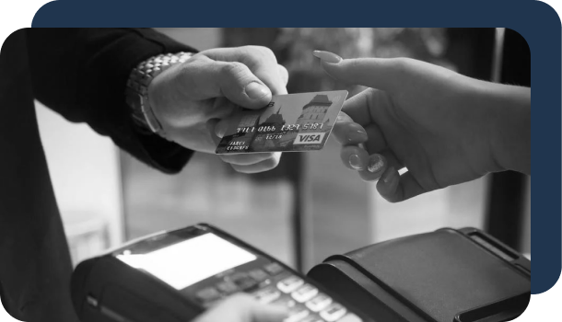
Fraudulent Transaction:
Detection & Prevention

Slide 2
Department of Computer Sciences
GOVT. ISLAMIA COLLEGE FOR WOMEN COOPER ROAD LAHORE
Affiliated with Lahore College for Women University
Presenters
2121110019 Bisma Rehman
2121110022 Eman Masood
2121110030 Hira Riaz
2121110043 Laiba Sheikh
Supervisor: Ms. Nadia

Slide 3

Introduction-Fraudulent Transaction
In an increasingly digital world, the prevalence of fraudulent transactions has risen sharply, posing significant threats to businesses and consumers alike. Fraudulent transactions refer to any unauthorized or deceptive financial activities that result in financial loss, often exploiting vulnerabilities in payment systems and consumer behavior. With advancements in technology and the growing sophistication of cybercriminals, traditional methods of fraud detection and prevention are continually challenged. This presentation aims to explore the various types of fraudulent transactions, their impacts on individuals and organizations, and the strategies employed to combat this pervasive issue. By understanding the landscape of fraud, we can better equip ourselves to protect against these threats and foster a more secure financial environment.

Slide 4
Part 01
How Credit Card Works
Part 02
Detection of CR Fraud
Part 03
Preventive Measures

Slide 5

Part 01
How credit Cards Works

Slide 6
How Credit Card Works
•Batch Processing: At the end of the business day, the merchant batches all approved transactions and sends them to the payment processor for settlement.
•Settlement Request: The payment processor sends a settlement request to the card network, which then forwards it to the respective issuing banks.
01
Initiation of Transaction
Routing to Issuing Bank
03
Incorporation of Companies
Authorization Request
Authorization Response
04
02
Completion of Transaction
Settlement Process
06
05
07
Completion of Transaction

Slide 7
How Credit Card Works
Funds Deduction: The issuing bank deducts the transaction amount from the cardholder’s available credit and transfers the funds to the acquiring bank (the bank that services the merchant).
Merchant Receives Funds: The acquiring bank credits the merchant’s account with the transaction amount, typically minus a transaction fee.
01
Initiation of Transaction
Routing to Issuing Bank
03
Working of Credit Card
Authorization Request
Authorization Response
04
02
Completion of Transaction
Settlement Process
06
05
07
Completion of Transaction

Slide 8
How Credit Card Works
Card Network: The card network routes the transaction details to the cardholder’s issuing bank (the bank that issued the credit card).
Fraud Check: The issuing bank checks for fraud, available credit, and other criteria.
01
Initiation of Transaction
Routing to Issuing Bank
03
Working of Credit Card
Authorization Request
Authorization Response
04
02
Completion of Transaction
Settlement Process
06
05
07
Completion of Transaction

Slide 9
How Credit Card Works
Approval or Denial: The issuing bank approves or denies the transaction based on the checks performed.
Response Sent Back: The authorization response is sent back through the card network to the payment processor, and then to the merchant.
01
Initiation of Transaction
Routing to Issuing Bank
03
Working of Credit Card
Authorization Request
Authorization Response
04
02
Completion of Transaction
Settlement Process
06
05
07
Completion of Transaction

Slide 10
How Credit Card Works
Transaction Confirmation: If approved, the merchant completes the sale, and a receipt is generated for the customer.
Funds Reserved: The amount of the transaction is reserved on the cardholder's credit limit.
01
Initiation of Transaction
Routing to Issuing Bank
03
Working of Credit Card
Authorization Request
Authorization Response
04
02
Completion of Transaction
Settlement Process
06
05
07
Completion of Transaction

Slide 11
How Credit Card Works
Batch Processing: At the end of the business day, the merchant batches all approved transactions and sends them to the payment processor for settlement.
Settlement Request: The payment processor sends a settlement request to the card network, which then forwards it to the respective issuing banks.
01
Initiation of Transaction
Routing to Issuing Bank
03
Working of Credit Card
Authorization Request
Authorization Response
04
02
Completion of Transaction
Settlement Process
06
05
07
Completion of Transaction

Slide 12
How Credit Card Works
Funds Deduction: The issuing bank deducts the transaction amount from the cardholder’s available credit and transfers the funds to the acquiring bank (the bank that services the merchant).
Merchant Receives Funds: The acquiring bank credits the merchant’s account with the transaction amount, typically minus a transaction fee.
01
Initiation of Transaction
Routing to Issuing Bank
03
Working of Credit Card
Authorization Request
Authorization Response
04
02
Completion of Transaction
Settlement Process
06
05
07
Completion of Transaction

Slide 13
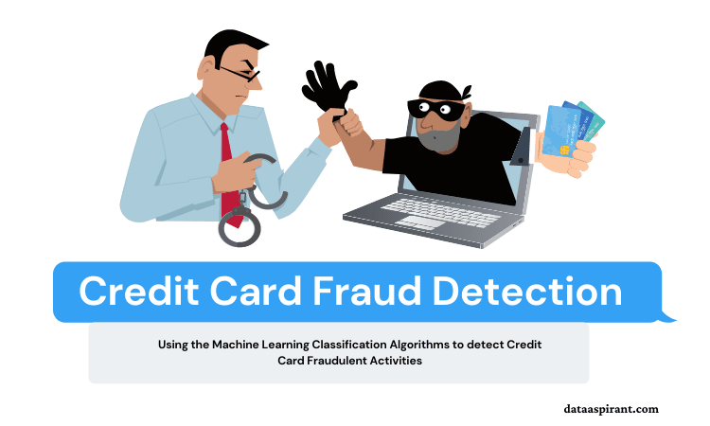
Part 02
Detection of Fraud

Slide 14
Detection Techniques
Rule-Based Systems
Logistic Regression
Deep Learning
01
02
07
02
Summary
03
06
03
Gradient Boosting
06
Neural Networks
04
05
04
05
Anomaly Detection
Clustering

Slide 15
Detection Techniques
01
• Rule-Based Systems
Logistic Regression
Deep Learning
01
Rule-Based System
07
02
A rule-based system is a computer system in which domain-specific knowledge is represented in the form of rules and general-purpose reasoning is used to solve problems in the domain.
Example: Blocking transactions over a certain amount from new IP addresses or locations
06
03
Gradient Boosting
Neural Networks
05
04
Anomaly Detection
Clustering

Slide 16
Detection Techniques
02
• Rule-Based Systems
Logistic Regression
Deep Learning
Logistic Regression
01
Logistic regression is a supervised machine learning algorithm that accomplishes binary classification tasks by predicting the probability of an outcome, event, or observation. The model delivers a binary or dichotomous outcome limited to two possible outcomes: yes/no, 0/1, or true/false.
07
02
06
03
Gradient Boosting
Neural Networks
05
04
Anomaly Detection
Clustering

Slide 17
Detection Techniques
03
• Rule-Based Systems
Logistic Regression
Neutral Networks
Deep Learning
01
A neural network is a method in artificial intelligence that teaches computers to process data in a way that is inspired by the human brain. It is a type of machine learning process, called deep learning, that uses interconnected nodes or neurons in a layered structure that resembles the human brain.
Capture complex patterns, suitable for large datasets.
07
02
06
03
Gradient Boosting
Neural Networks
05
04
Anomaly Detection
Clustering

Slide 18
Detection Techniques
• Rule-Based Systems
04
Logistic Regression
Deep Learning
01
Clustering
07
02
Clustering is an unsupervised machine learning technique designed to group unlabeled examples based on their similarity to each other. (If the examples are labeled, this kind of grouping is called classification.) Consider a hypothetical patient study designed to evaluate a new treatment protocol.
Grouping transactions to identify outliers that could indicate fraud.
06
03
Gradient Boosting
Neural Networks
05
04
Anomaly Detection
Clustering

Slide 19
Detection Techniques
05
• Rule-Based Systems
Logistic Regression
Anomaly Detection
Deep Learning
01
Anomaly detection in machine learning is the process of using machine learning models to identify anomalies rapidly. This serves several purposes, whether to maintain clean, high-quality data that you will use for processing or specific business purposes.
Techniques like Isolation Forests that detect abnormal transactions.
07
02
06
03
Gradient Boosting
Neural Networks
05
04
Anomaly Detection
Clustering

Slide 20
Detection Techniques
06
• Rule-Based Systems
Logistic Regression
Gradient boosting is a type of machine learning boosting. It relies on the intuition that the best possible next model, when combined with previous models, minimizes the overall prediction error. The key idea is to set the target outcomes for this next model in order to minimize the error.
Builds models sequentially, focusing on correcting errors made by previous models.
Deep Learning
01
07
02
06
03
Gradient Boosting
Neural Networks
05
04
Anomaly Detection
Clustering

Slide 21
Detection Techniques
07
• Rule-Based Systems
Logistic Regression
Deep Learning
Deep Learning
01
01
Utilizing models like LSTMs (Long Short-Term Memory networks) for sequential data analysis in transaction patterns.
02
07
02
07
03
06
03
Gradient Boosting
Neural Networks
04
05
04
05
Anomaly Detection
Clustering

Slide 22
01
Accuracy
02
Precision
03
Recall (Sensitivity)
04
F1 Score
Evaluation Parameters
05
ROC-AUC
06
Confusion Matrix
RLNG LPS and Finance cost
08

Slide 23
Evaluation Parameters
Accuracy
01
02
03
04
05
06
The proportion of true results (both true positives and true negatives) among the total number of cases examined.
Take it as a percentage number for both true and negative
Recall (Sensitivity)
ROC-AUC
Precision
F1 Score
Confusion Matrix
Accuracy
Notes:
Please share FY 21-22 UFG numbers and projected disallowances at each quarter.
What is the basis of our calculation of disallowance
Has OGRA shared with us the calculation details of 76 %

Slide 24
Evaluation Parameters
Precision
01
02
03
04
05
06
The ratio of true positive results to the total predicted positives (true positives + false positives).
Recall (Sensitivity)
ROC-AUC
Precision
F1 Score
Confusion Matrix
Accuracy
Notes:
What is the total amount accrued so far?
What is the breakdown of deferred, allowed and disallowed.

Slide 25
Evaluation Parameters
Recall (Sensitivity)
01
02
03
04
05
06
The ratio of true positives to the actual positives (true positives + false negatives).
Recall (Sensitivity)
ROC-AUC
Precision
F1 Score
Confusion Matrix
Accuracy
Notes:
1) What was the amount last year?
2) What is the calculation detail of Actuarial losses provided last year and accrued during the year?
3)

Slide 26
Evaluation Parameters
F1 Score
01
02
03
04
05
06
The harmonic mean of precision and recall, useful for imbalanced datasets.
Recall (Sensitivity)
ROC-AUC
Precision
F1 Score
Confusion Matrix
Accuracy
Notes:
Year wise breakdown of Cost of Supply of last years
SSGC cost of supply, is it the same issue as SNGPL case was?
SSGC GIC, what is the break down and for how many years this disallowance relate to?
Excess allowed, what is the amount claimed and excess allowed?

Slide 27
Evaluation Parameters
ROC-AUC
01
02
03
04
05
06
A measure of the model’s ability to distinguish between classes; higher values indicate better performance.
Recall (Sensitivity)
ROC-AUC
Precision
F1 Score
Confusion Matrix
Accuracy
Notes:
1) Please give breakdown of total incurred and allowed.
2) Breakdown of Director’s meetings for the last 3 years (already available) by each sub committee and each director’s remuneration.
3) Are we in compliance of additional disclosures required for director’s fee/remuneration enacted through Companies Act 2017.

Slide 28
Evaluation Parameters
Confusion Matrix
01
02
03
04
05
06
A tool for visualizing the performance of a classification model.
Recall (Sensitivity)
ROC-AUC
Precision
F1 Score
Confusion Matrix
Accuracy
Notes:
Calculation break down of ECL for current year and prior year

Slide 29







Challenges

Slide 30
Challenges
Fraud detection often involves a small percentage of fraudulent cases, leading to challenges in model training.
Imbalanced Datasets

Slide 31
Challenges
Fraud techniques change rapidly, necessitating continuous model updates and retraining.
Evolving Fraud Tactics

Slide 32
Challenges
Data Privacy Concerns
Compliance with regulations like GDPR when using personal data for fraud detection.

Slide 33
Challenges
False Positives
Legitimate transactions flagged as fraudulent can lead to customer dissatisfaction.

Slide 34
Part 03
Ideas to Prevent Frauds

Slide 35
Prevention Measures
1
Importance of Real-Time Detection
Systems must analyze transactions instantly to minimize losses and enhance user trust.

Slide 36
Prevention Measures
1
2
Importance of Real-Time Detection
Integration of AI
Systems must analyze transactions instantly to minimize losses and enhance user trust.
Advanced AI algorithms can significantly improve detection accuracy and adapt to new fraud patterns.

Slide 37
Prevention Measures
1
2
3
Importance of Real-Time Detection
Integration of AI
Continuous Monitoring and Adaptation
Systems must analyze transactions instantly to minimize losses and enhance user trust.
Advanced AI algorithms can significantly improve detection accuracy and adapt to new fraud patterns.
The necessity for ongoing analysis and model retraining to keep up with evolving tactics.

Slide 38
Prevention Measures
1
2
3
4
Importance of Real-Time Detection
Integration of AI
Continuous Monitoring and Adaptation
Collaborative Efforts
Systems must analyze transactions instantly to minimize losses and enhance user trust.
Advanced AI algorithms can significantly improve detection accuracy and adapt to new fraud patterns.
The necessity for ongoing analysis and model retraining to keep up with evolving tactics.
Financial institutions sharing data on fraud patterns can enhance overall detection capabilities.

Slide 39


